Slide 1

Cancer patient dashboard
Presented by: Nimra Sultan

Slide 2
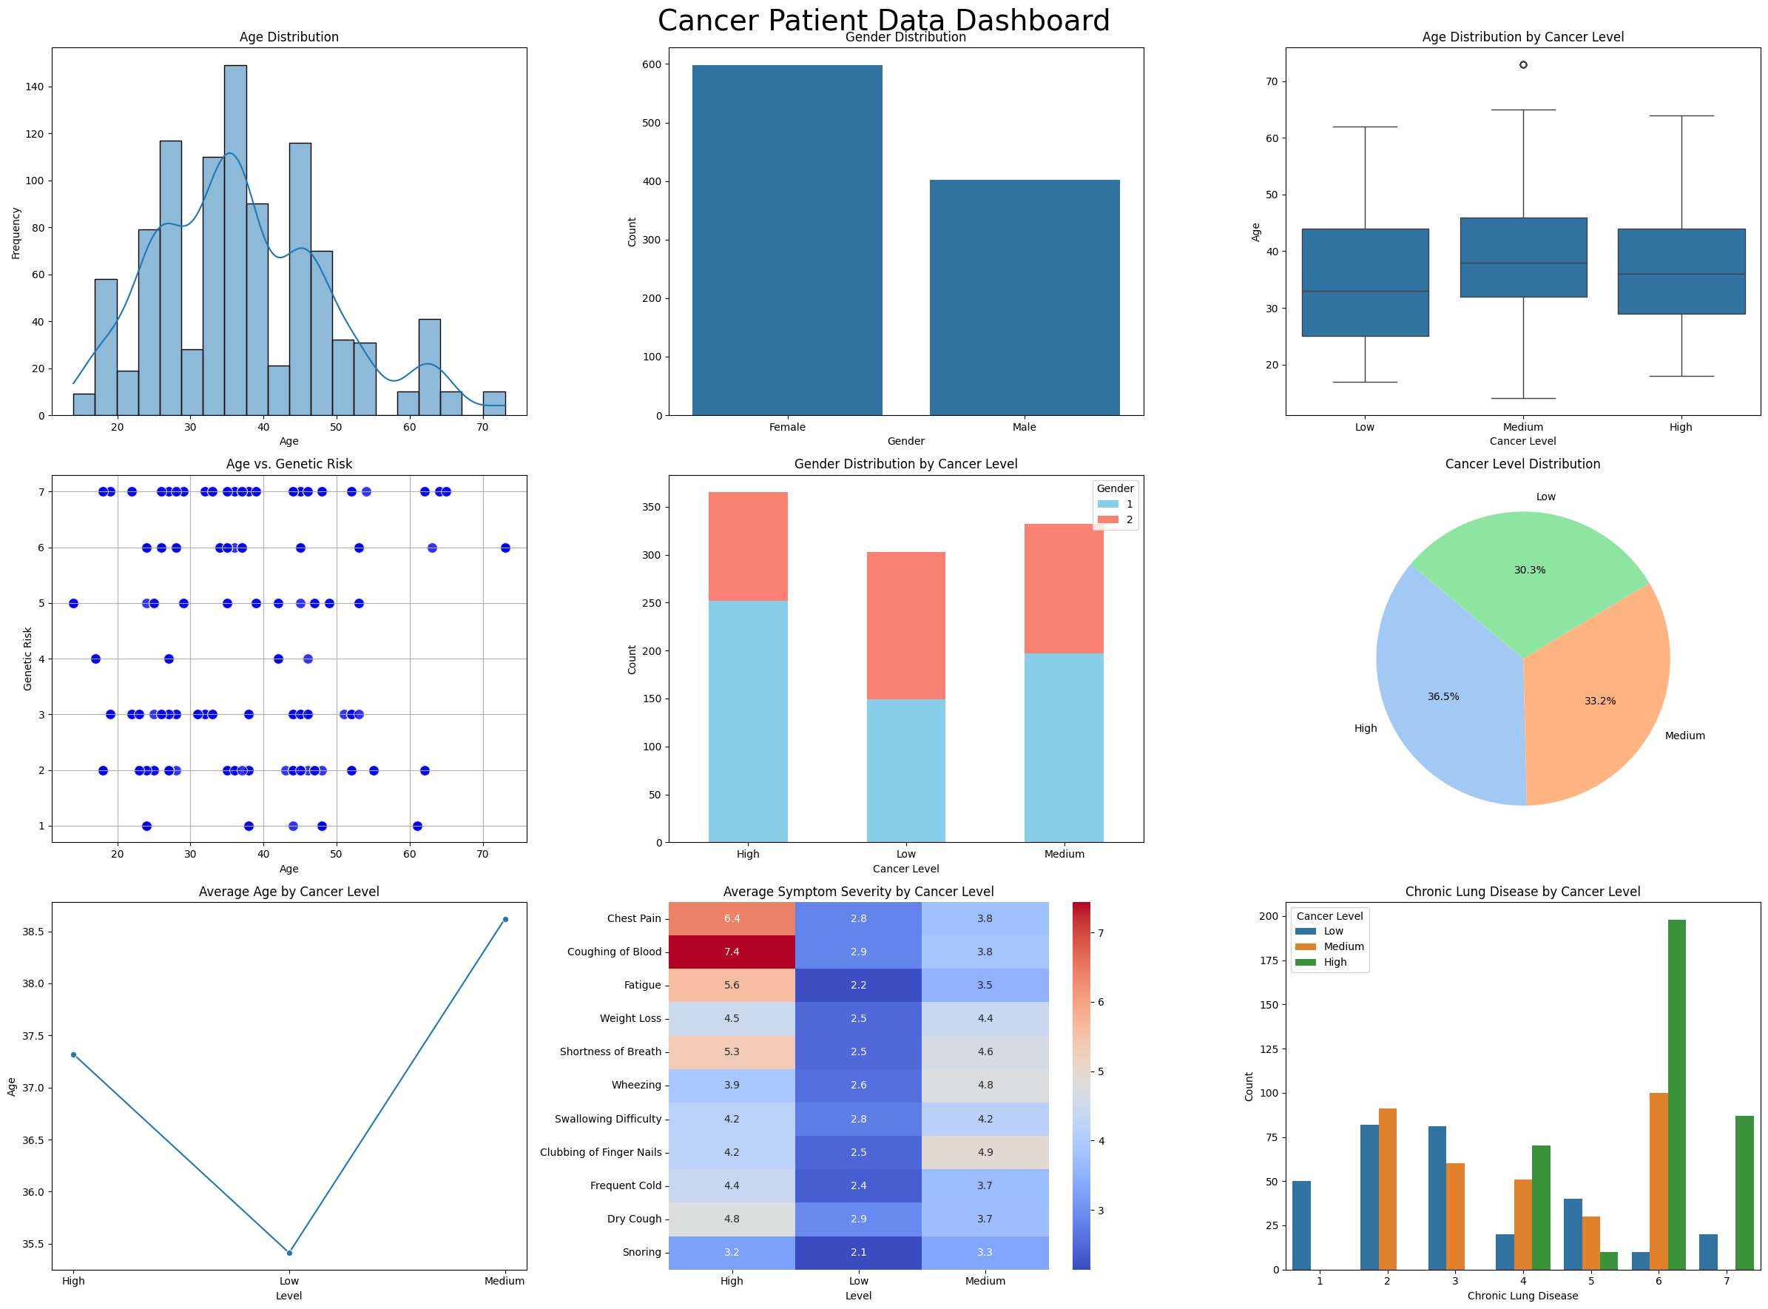

Slide 3
